Slide 1
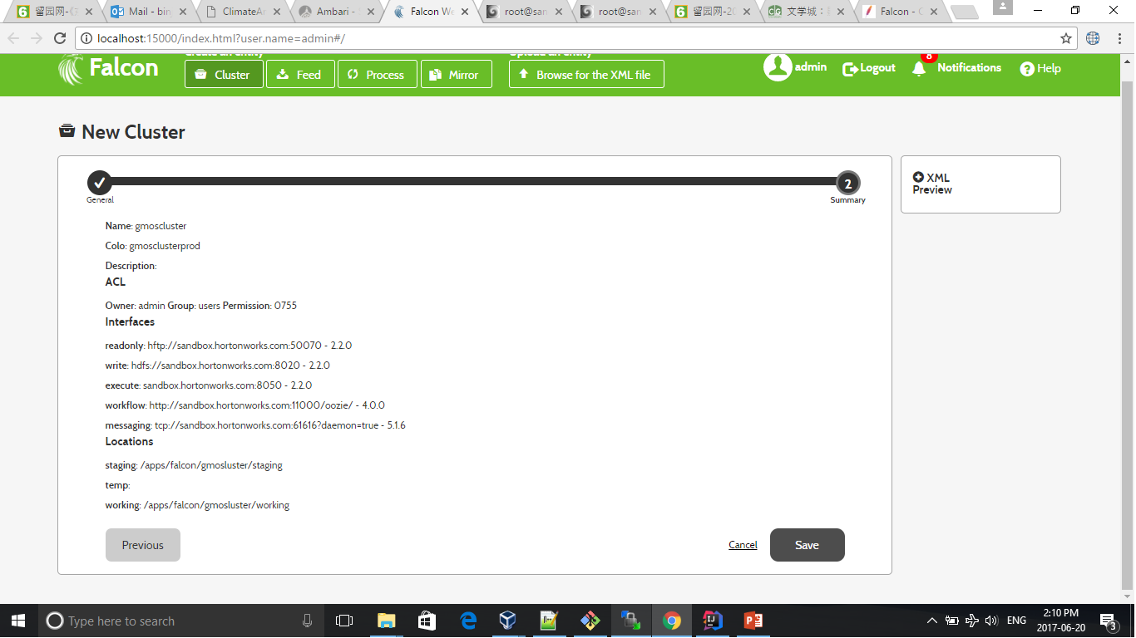
Falcon Cluster Configuration

Slide 2
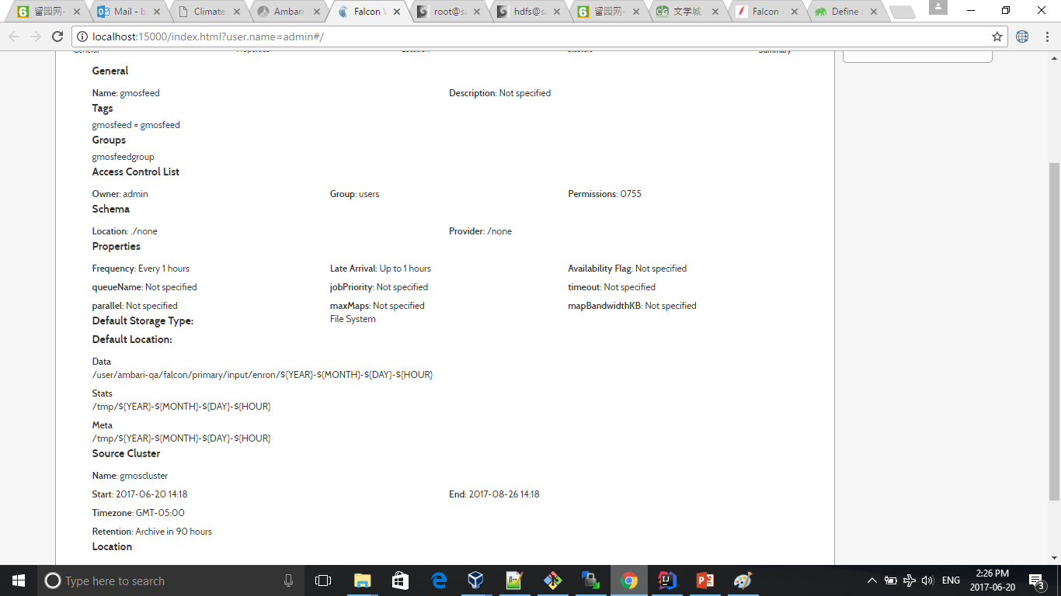
Falcon Feed Configuration

Slide 3
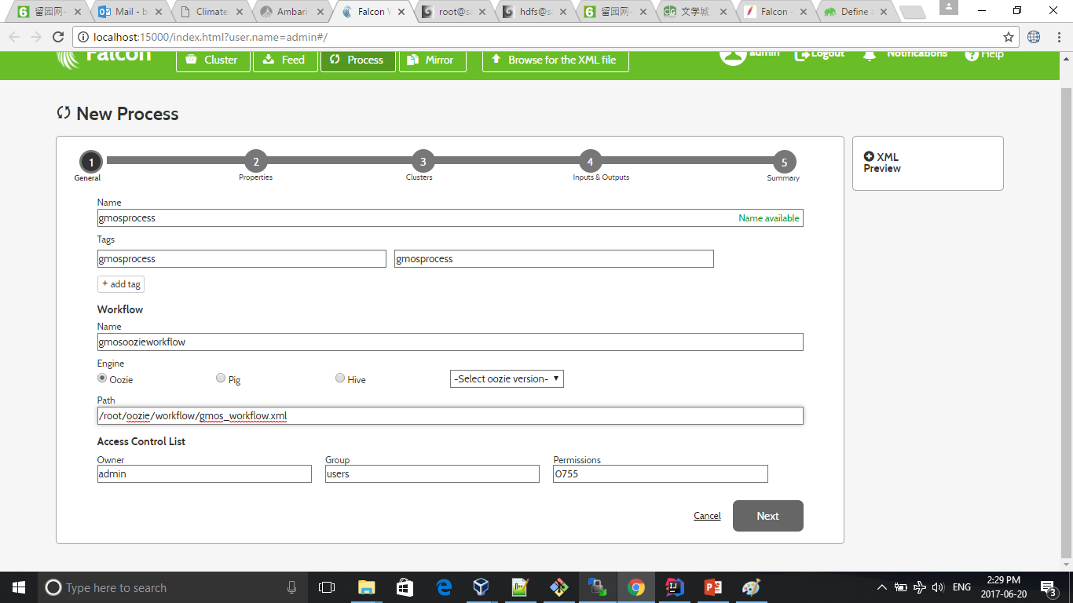
Falcon Process Configuration

Slide 4
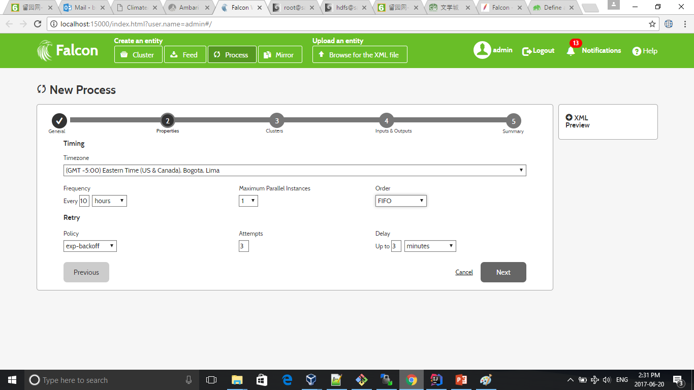
Falcon Process Configuration

Slide 5
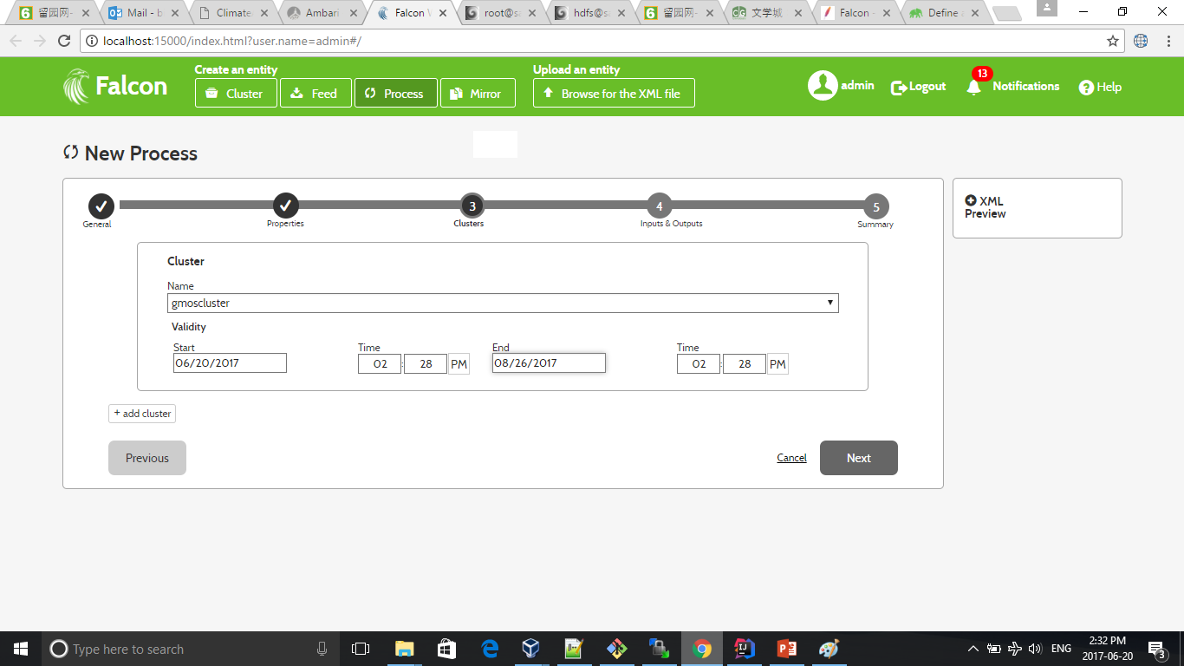
Falcon Process Configuration

Slide 6
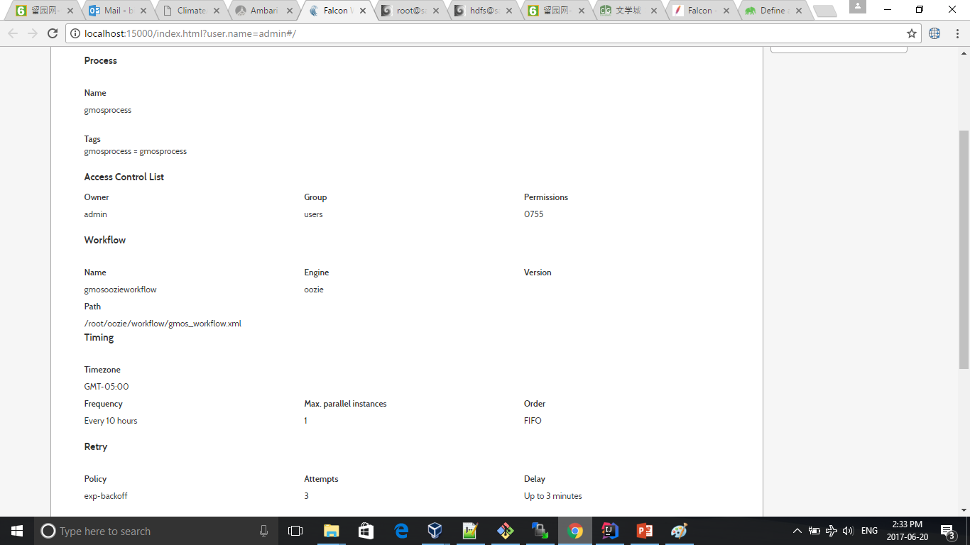
Falcon Process Configuration

Slide 7
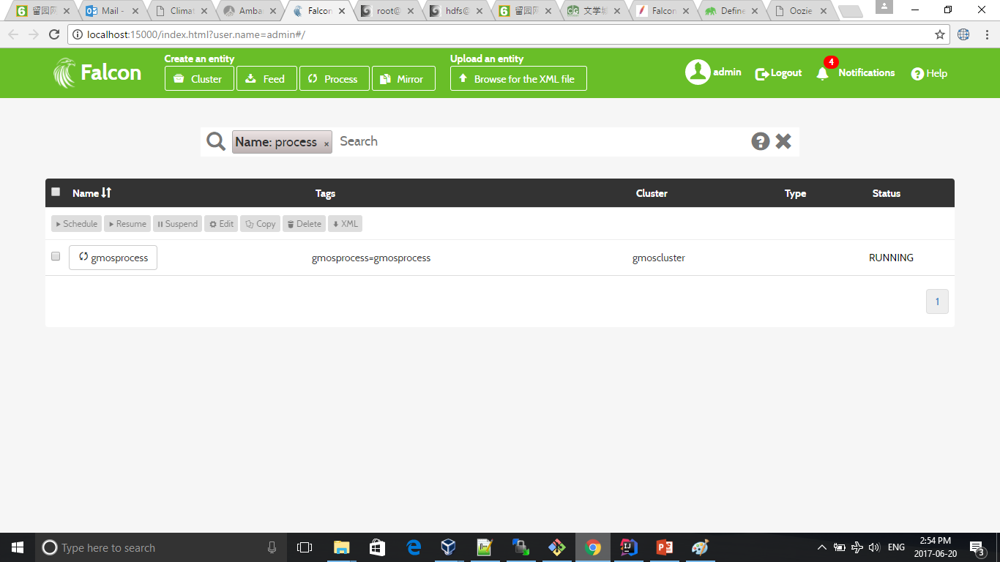
Falcon Running Status

Slide 8
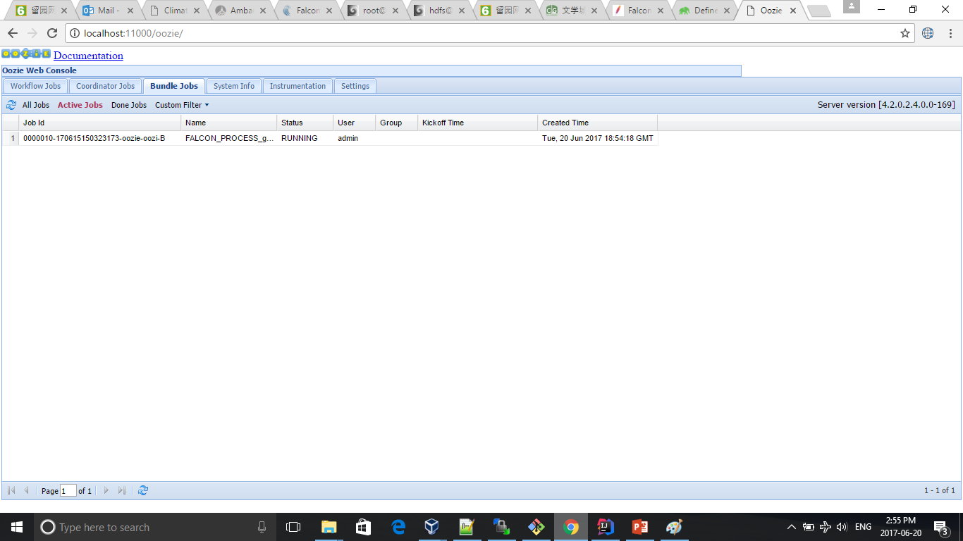
Oozie Bundle Triggered Falcon Data Management

Slide 9
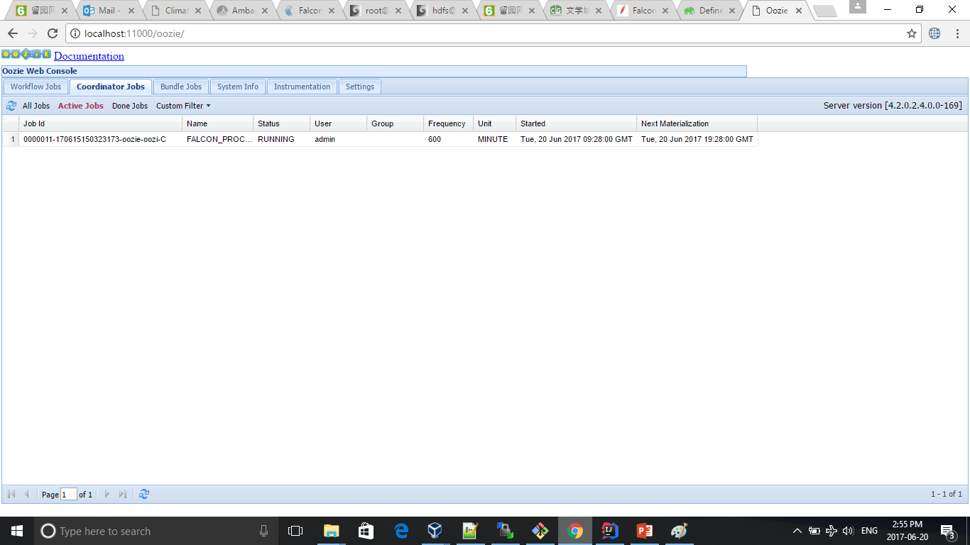
Oozie Coordinator Triggered Falcon Data Management

Slide 10
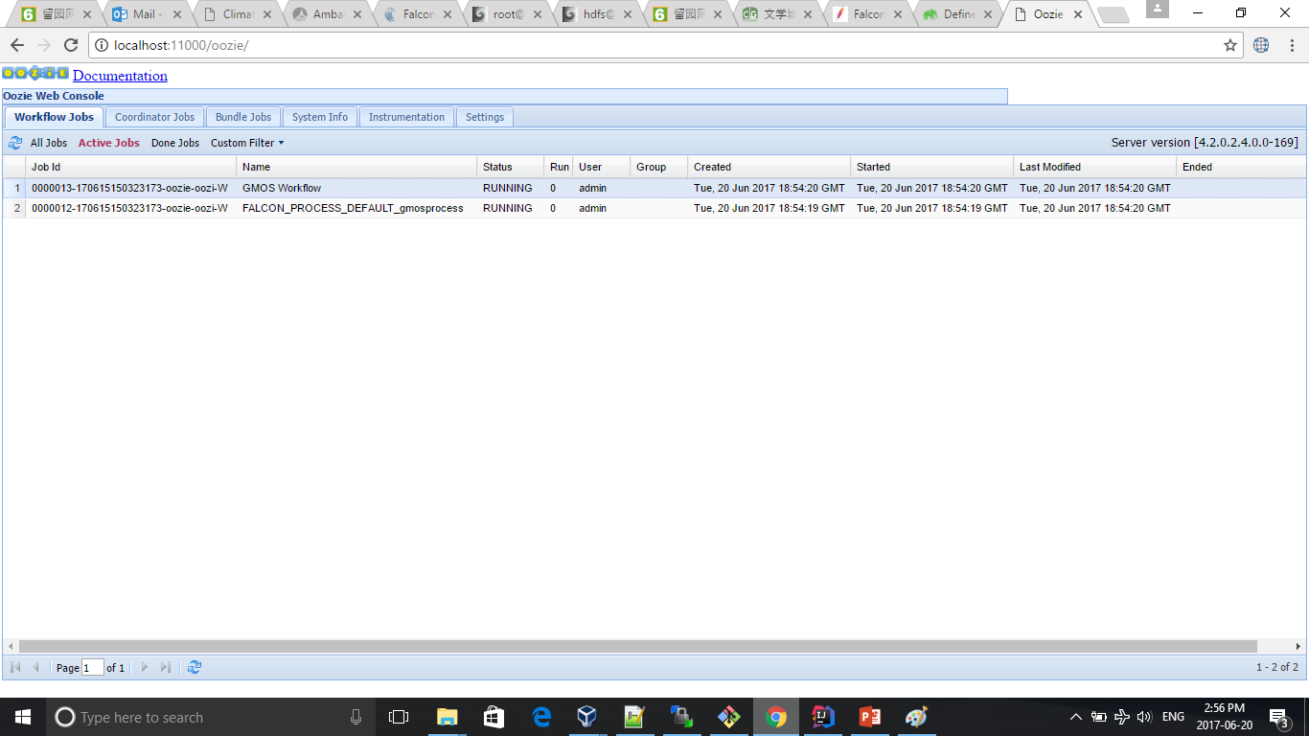
Oozie Workflow Triggered Falcon Data Management

Slide 11
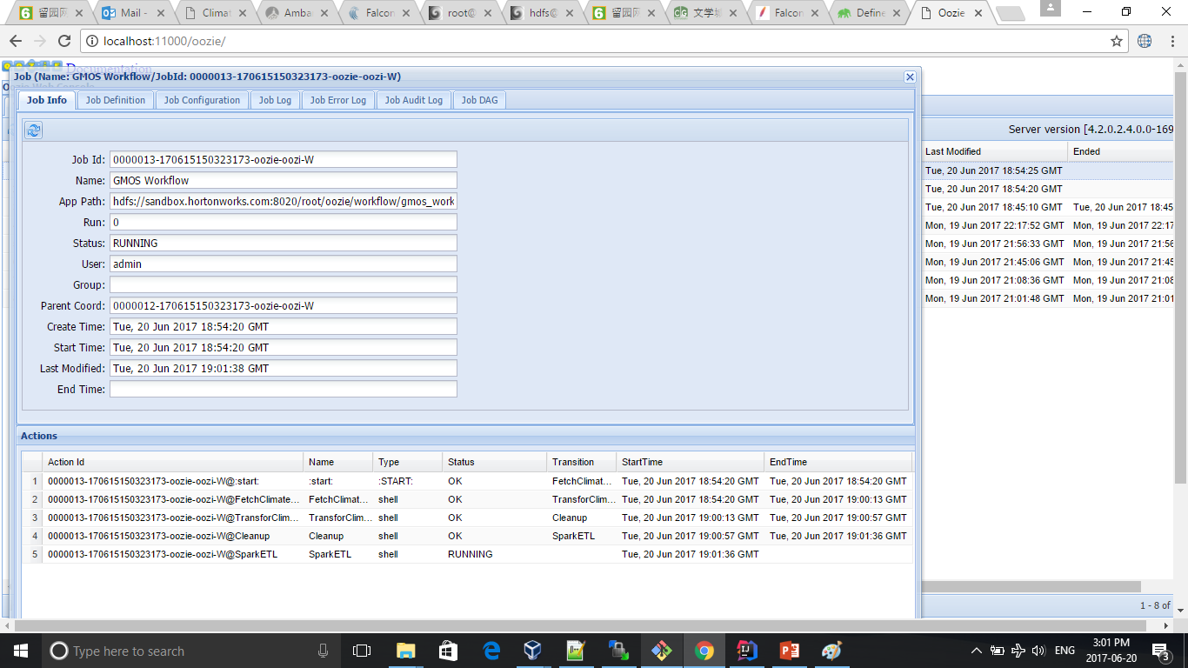
Oozie Workflow Triggered Falcon Data Management

